Slide 1
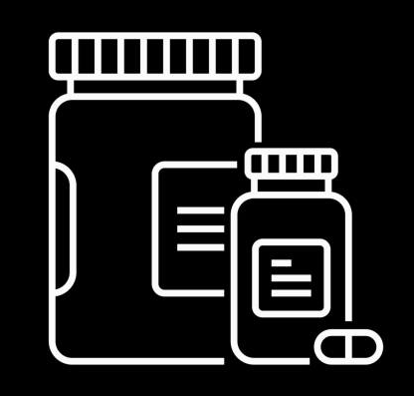
Dr. Pill
Automatic Pill Dispenser
Dr. Pill

Slide 2





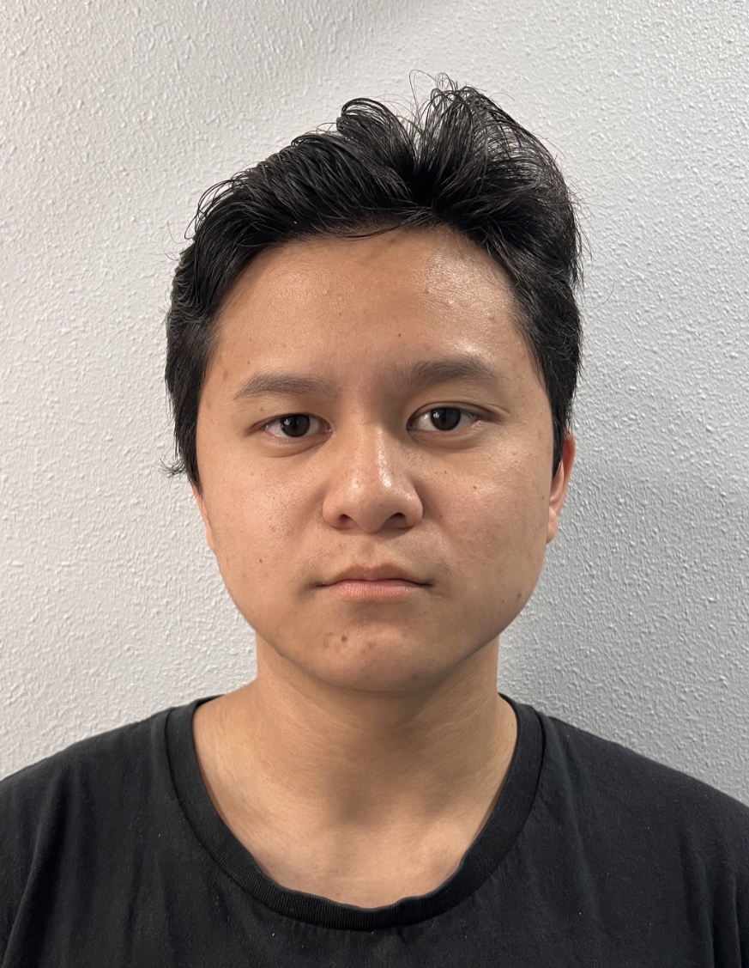
Team & Roles
Jonathan Cerniaz
Jehmel
Espiritu
Jeremy Espiritu
Joseph Guzman
Afzal
Hakim
Lee Roger
Ordinario
Team Management
Power Supply
Touchscreen display
Circuitry
Launchpad Implementation
Motor Movement
Motor Hardware Set Up
Object recognition
Pill Sizing and Weight
Help with Motor Implementation
GitHub Manager
Raspberry Pi Implementation
3D Design and Build
Space management
User Interface
Security Device Integration
Log Management and Data Tracking
Pill Storage Design
Pill Dispense Concept
Dispenser Sanitation

Slide 3
EXECUTIVE SUMMARY
Dr. Pill is an automatic pill dispenser that simplifies medication management. Our device aims to facilitate the process by freeing up more time for doctors and allowing patients to take their medication accurately by eliminating the common issue of medication errors and missed dosages.
Designated for pharmacies, nursing homes, personal households.
Dr. Pill

Slide 4
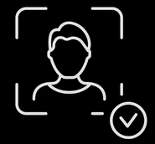
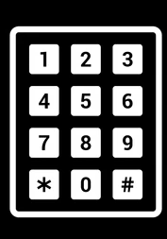
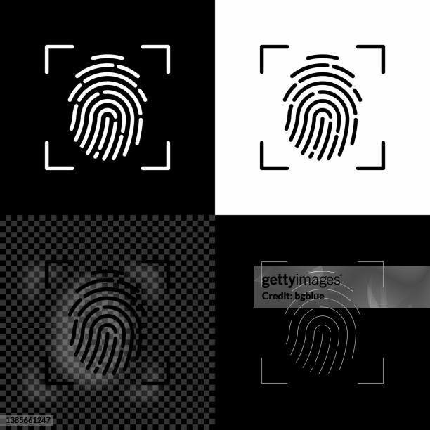
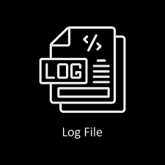

FEATURES
Automated Dispensing
Say goodbye to missed doses and medication errors. Dr. Pill automatically dispenses your prescribed medications at the precise times, every time.
User-Friendly Interface
Designed for users of all ages and technical abilities, Dr. Pill's intuitive interface makes medication management a breeze.
Biometric Authentication
To ensure that medications are dispensed to the correct person, Dr. Pill offers facial recognition and fingerprint scanning capabilities.
Dedicated Pill Storage and Delivery
Dr. Pill features separate compartments for each type of medication, ensuring there is no cross-contamination between different pills.
Tracking Logs
Dr. Pill keeps detailed tracking logs of when medications are dispensed and consumed.
Dr. Pill

Slide 5
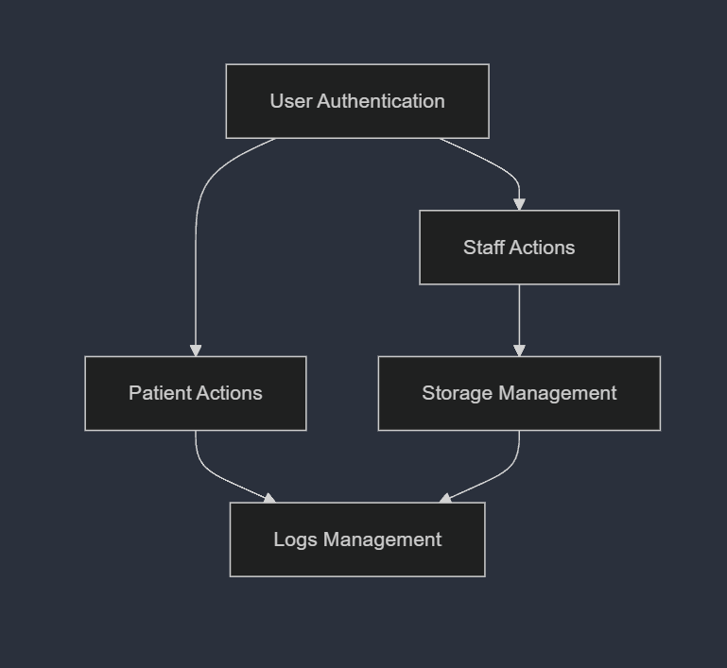
BLOCK DIAGRAM (SIMPLIFIED)
Dr. Pill

Slide 6
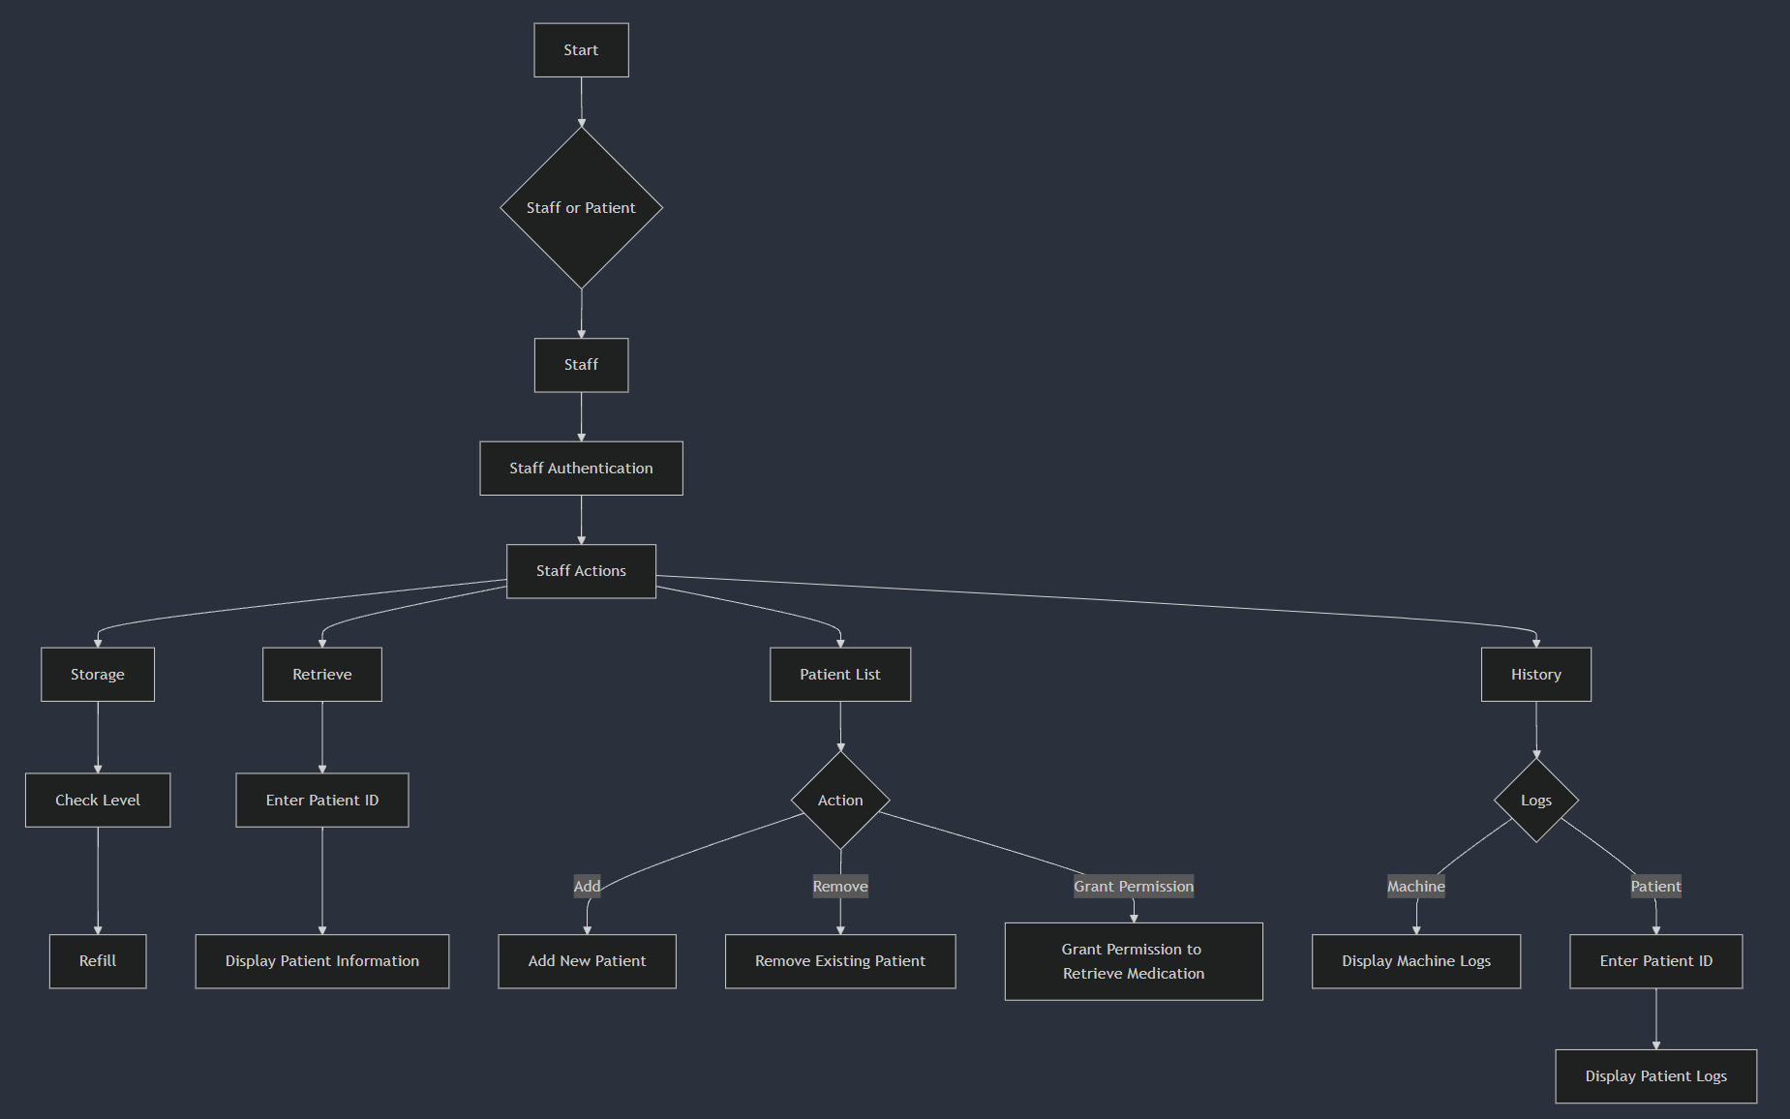
STAFF DIAGRAM
Dr. Pill

Slide 7
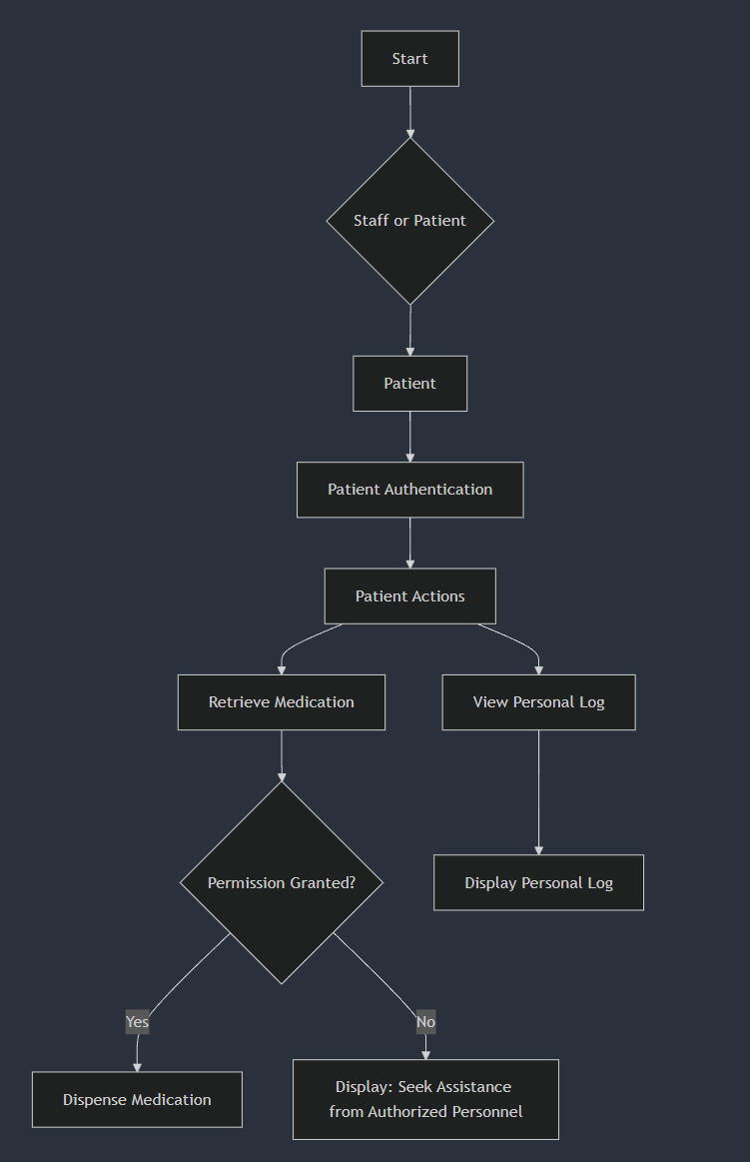
PATIENT DIAGRAM
Dr. Pill

Slide 8
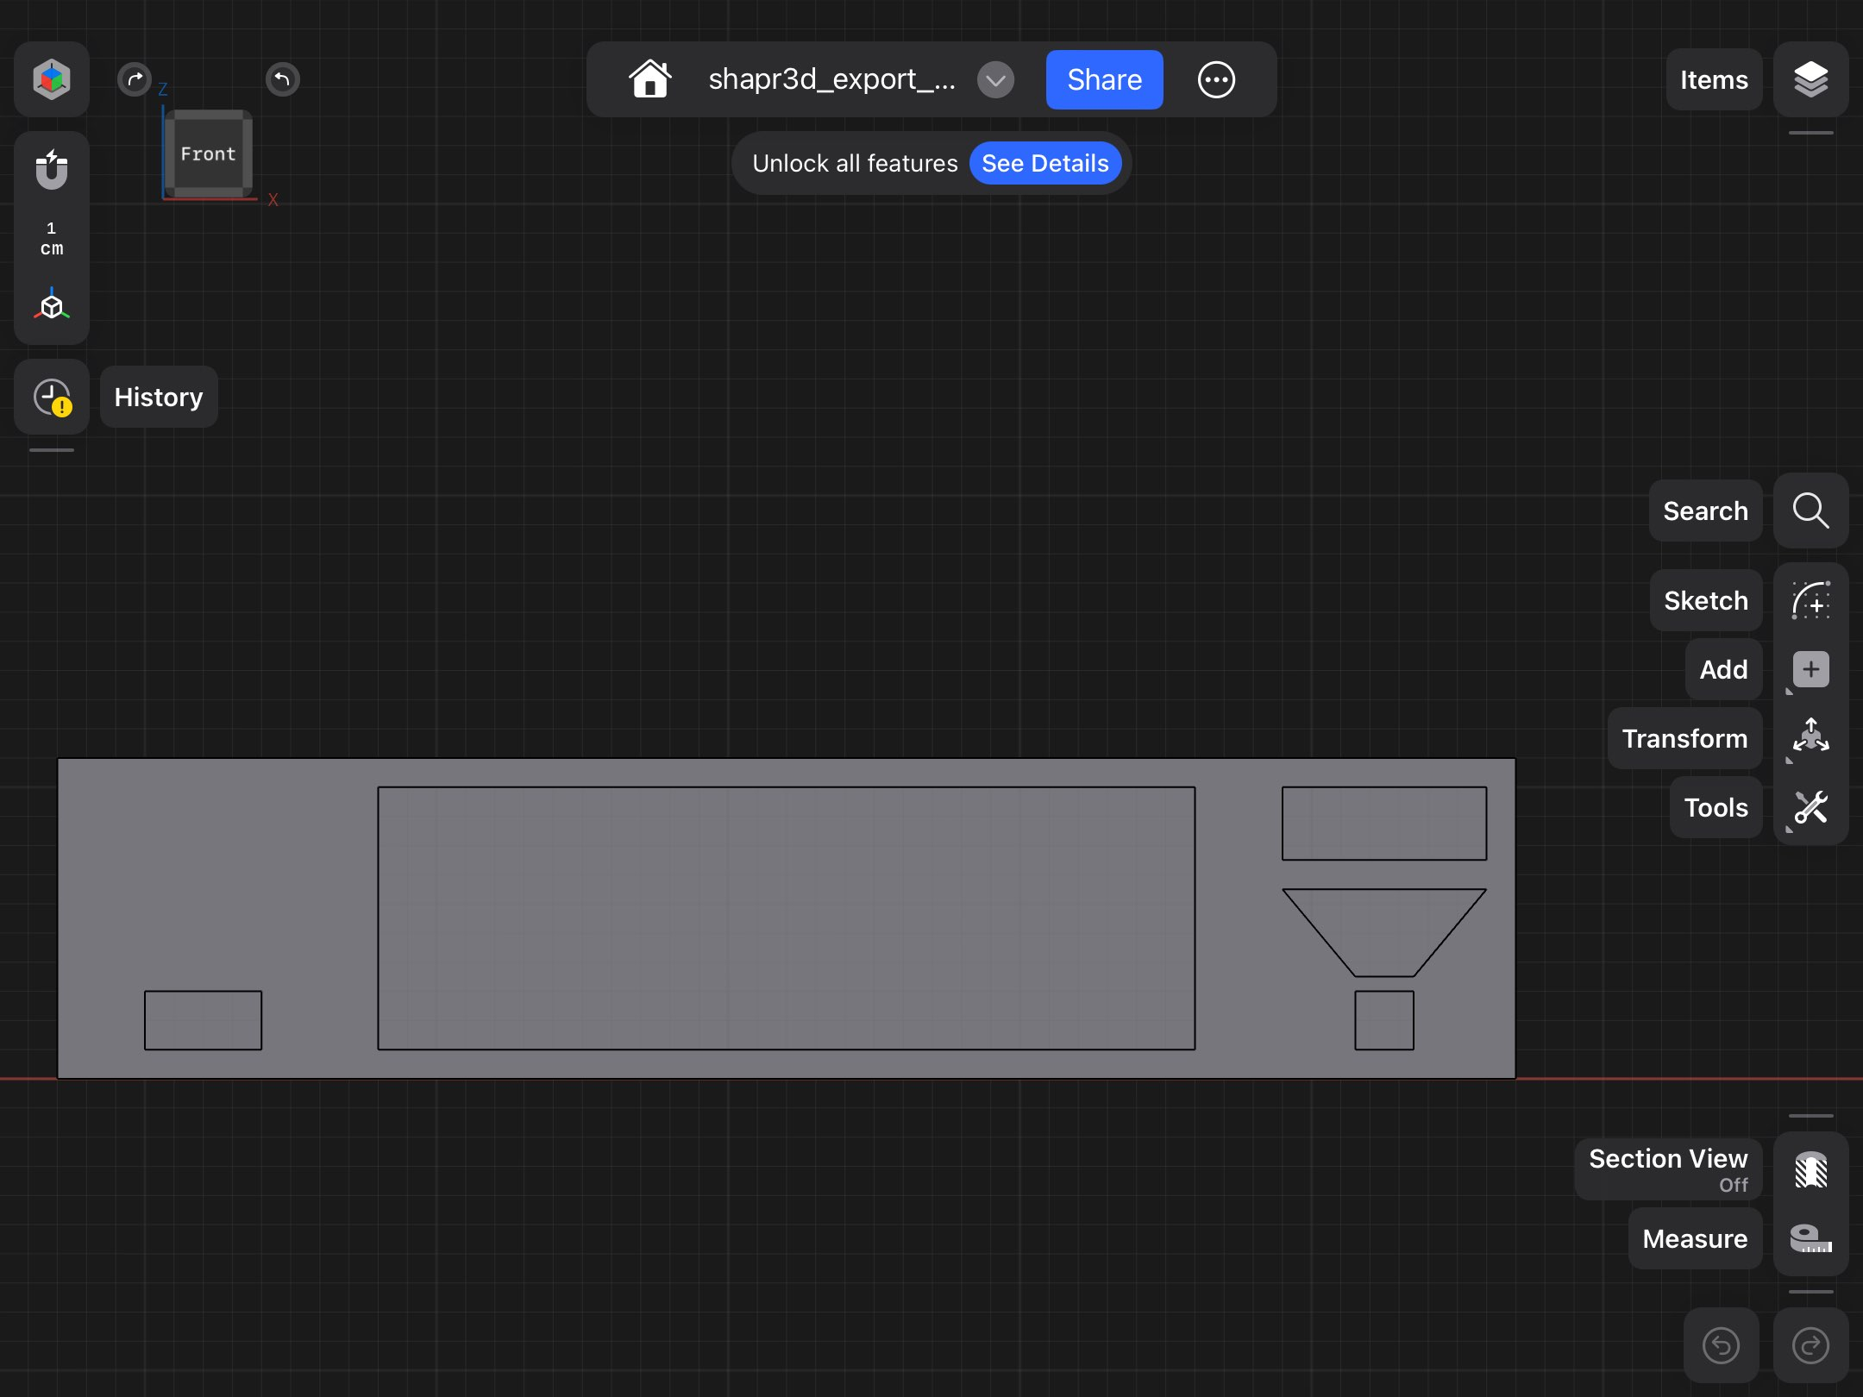
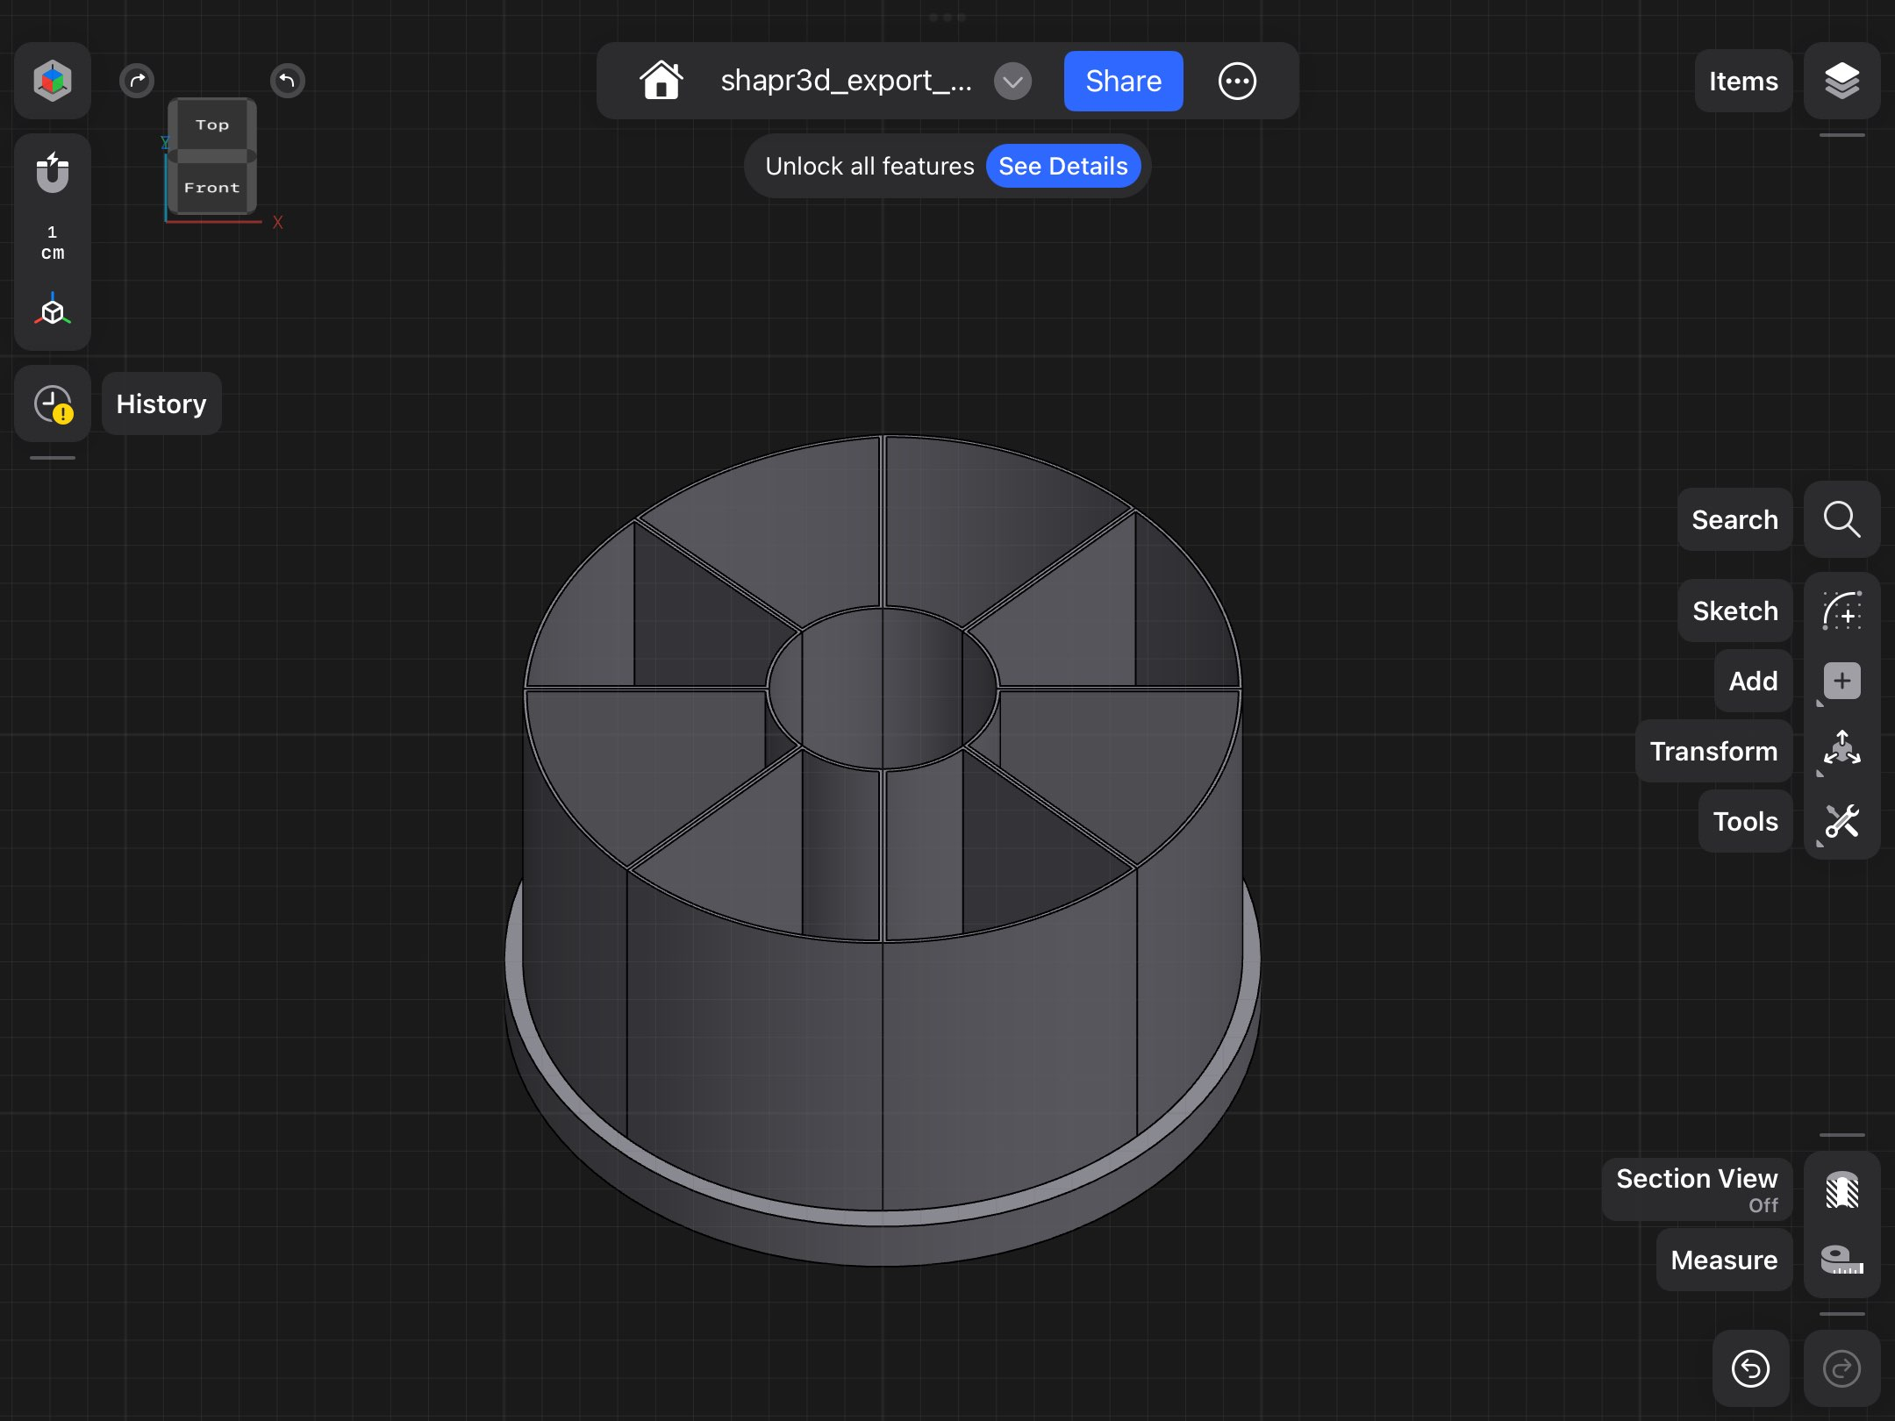
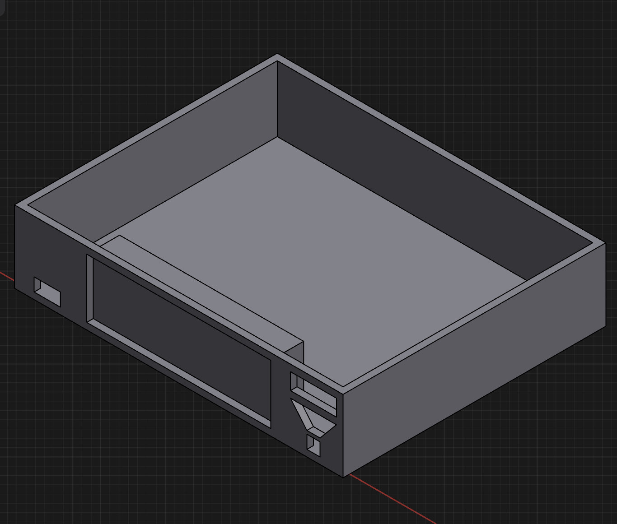
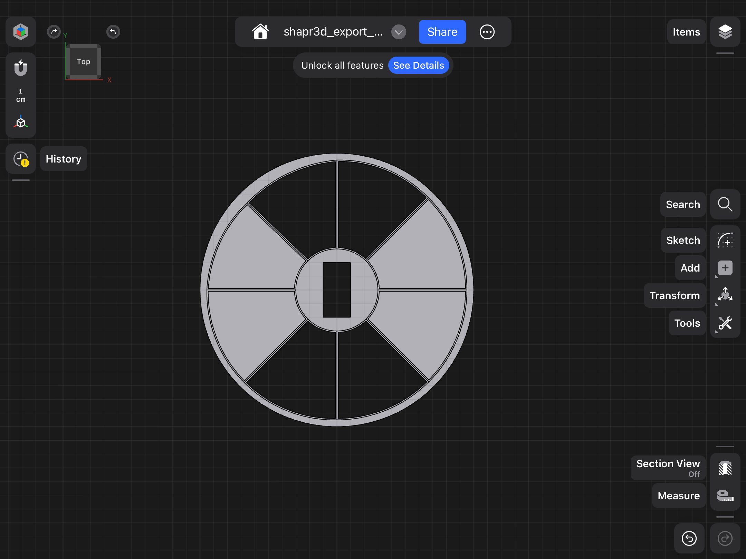
DESIGN
Dr. Pill Front Interface
Dispense Mechanism
Blueprint Layout
Pill Storage and Operation
Top View
Top View
Dispense Location
TM4C123GH6PM
Raspberry Pi
Power Supply
LCD Display
Authenticator
Dr. Pill

Slide 9
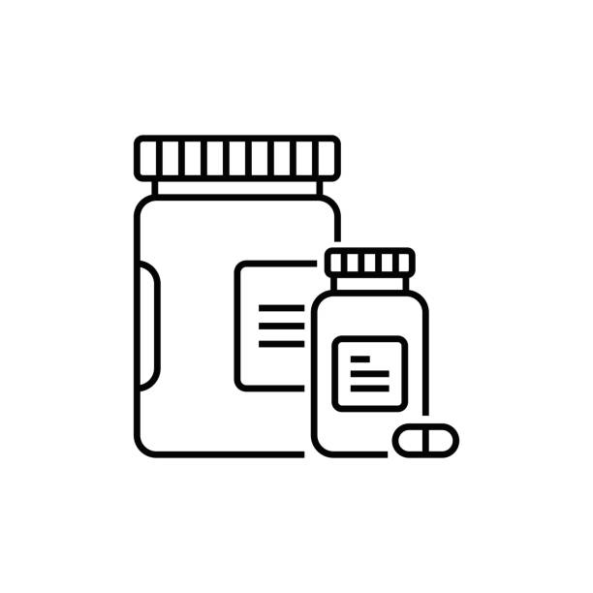
Progress
What was planned but not accomplished?
What was planned and accomplished?
Object recognition for identification of pills as well as the placement for the device
Circuit management and power consumption
Software development for our dispensing mechanism
Develop a user interface for patients and authorized personnel
Create a data tracker for pill history
Researched 'generally recognized as safe' (GRAS) materials for pill storage and enclosure
Recognized safety issue for storing medication, considering crushed medication, cross-contamination, potency, and sizing
Conducted research on the average daily medication intake for older adults and the elderly to tailor the product to their needs
Explored motor options, that will be utilized for our dispensing mechanism
Constructed a 3D print of our prototype design
Dr. Pill

Slide 10
Start Software
Oct 7, 2024
10 days
104 days
108 days
82 days
70 days
26 days
2024
TIMELINE
Research
Sep 23 - Oct 7
Hardware
Sep 1 - Oct 7
Designing and Planning
Aug 26 - Dec 18
Hardware Development
Oct 1 - Mar 1
Software Development
Oct 7 - Mar 1
Integration and Testing
Feb 1 - May 9
Aug
Sep
Oct
Nov
Dec
Jan
Feb
Mar
Apr
May
2025
Today
Sep 27, 2024
Prototype Design
Dr. Pill

Slide 11
REFERENCES
Alam, Md Tausif, et al. “FDA-Approved Natural Polymers for Fast Dissolving Tablets.” Journal of Pharmaceutics, U.S. National Library of Medicine, https://www.ncbi.nlm.nih.gov/pmc/articles/PMC4590815/
Alei. “Pill Size Chart.” AIPAK, 9 Apr. 2024, www.icapsulepack.com/pill-size-chart/.
Charlesworth, Christina J, et al. “Polypharmacy Among Adults Aged 65 Years and Older in the United States: 1988-2010.” The Journals of Gerontology. Series A, Biological Sciences and Medical Sciences, U.S. National Library of Medicine, www.ncbi.nlm.nih.gov/pmc/articles/PMC4573668/.
Craig M. Hales, M.D., M.P.H., Jennifer Servais, B.Sc., Crescent B. Martin, M.P.H., M.A., and Dafna Kohen, Ph.D., M.Sc., “Products - Data Briefs - Number 347 - August 2019.” Centers for Disease Control and Prevention, 14 Aug. 2019, https://www.cdc.gov/nchs/products/databriefs/db347.htm#:~:text=Among%20U.S.%20adults%20aged%2060,proton%20pump%20inhibitors%20(16.9%25/
Ferro Uriguen, Alexander, et al. “Determination of the Cross-Contamination and Validation of the Cleaning Process for an Automated Personalised Dosing System.” European Journal of Hospital Pharmacy : Science and Practice, U.S. National Library of Medicine, www.ncbi.nlm.nih.gov/pmc/articles/PMC9047934/.
Formlabs, “The Essential Guide to Food Safe 3D Printing.” Formlabs, formlabs.com/blog/guide-to-food-safe-3d-printing/.
Irfan’s Idiotic Ideas, “How To Make A Conveyor Belt System At Home || Conveyor Belt Model || Homemade Conveyor Belt” YouTube, www.youtube.com/watch?app=desktop&v=8Vnoso8rhaw.
Dr. Pill

Slide 12
REFERENCES
J. Mark Ruscin, Sunny A. Linnebur, “Aging and Medications - Aging and Medications.” Merck Manual Consumer Version,
www.merckmanuals.com/home/older-people%E2%80%99s-health-issues/aging-and-medications/aging-and-medications.
“Pill Counting Scales.” DSCBalances, www.dscbalances.com/collections/pill-counting-scales.​
Ranjit’s Embedded Solutions, “Arduino-based Conveyor Belt Using DC Motor with RPM Control And Object Counting”, YouTube, www.youtube.com/watch?v=VHAqJ9a7SqI.
Rosemont Pharma, “Rosemont: Information For Patients On The Dangers Of Tablet Crushing.”, 14 Oct. 2023, www.rosemontpharma.com/tablet-crushing/.
Wang, Nathan, “What Is PLA Plastic? Benefits, Uses, and Safety of PLA Material!” Onenice Internaional Co., Ltd., 30 July 2024, www.geckohaha.com/what-is-pla-plastic/.
YouTube: Best Automatic Pill Dispensers [November 2021], www.youtube.com/watch?v=ffu1d6DnqjQ.
YouTube: Count Right Pill Counter (J1245n) - Inventory, www.youtube.com/watch?v=l1ECQJ63jCg.
YouTube: Electronic Tablet Counter: RX 4 Capsule Counter Machine by RX Count, www.youtube.com/watch?v=mO_NhPjw8f0.
Dr. Pill

Slide 13
THANK YOU
Dr. Pill

